Slide 1

CSE4227 Digital Image Processing
Chapter 9 – Morphological Image Processing- (Part-II)
Dr. Kazi A Kalpoma
Professor, Department of CSE
Ahsanullah University of Science & Technology (AUST)
Contact: kalpoma@aust.com
Google Class code: o5sjihh
CSE | AUST
Fall 2022

Slide 2
Today’s Contents
Morphology: pixel shape based analysis
      Hit-and-Miss Transformation
      Thinning, and
      Thickening
Chapter 9 from R.C. Gonzalez and R.E. Woods, Digital Image Processing (3rd Edition), Prentice Hall, 2008 [ Section 9.4, 9.5.1, 9.5.5, 9.5.6 ]
http://www.imagemagick.org/Usage/morphology/#hmt
Notes:
kalpoma@gmail.com

Slide 3



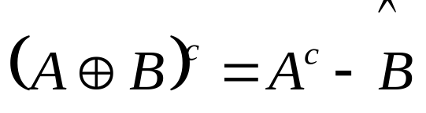


Review of last lecture…………
Erosion
Dilation
Dilation and erosion are duals of each other:
Opening
Closing

Slide 4
Hit-or-miss Transform
commonly known as "HMT“
is a high level morphology method
is specifically designed to find and locate specific patterns or shape in images.
by looking for a specific configuration of 'foreground' and 'background' pixels around the 'origin'.
The 'Structuring Element' used can contain a pattern of 3 types of elements only:
  a value of '1' meaning 'foreground',
  a value of '0' meaning 'background', and
  also a third element which can be specified as either 'Nan', or 'I Don't Care' or 'Any Pixel‘
All other morphological operations can be derived from it!!

Slide 5
Hit-and-miss Transform
If foreground and background pixels in the structuring element exactly match foreground and background pixels in the image,
then the pixel underneath the origin of the structuring element is set to the foreground color.

Slide 6
Hit-or-Miss Transform
A tool for shape detection or for the detection of a disjoint region in an image
Idea
  Suppose we have a binary image that contains certain shapes (circles, squares, lines, etc,….) called image A
  We use another image or matrix to search image A for a particular pattern of bits. We will call this pattern “shape B”
  We then search image A for shape B
  Whenever there is a ‘hit’, we indicate where the center of shape B was on image A.
Watch out: We actually look for ‘fits’ but we will be calling them ‘hits’ when talking about hit-or-miss transform

Slide 7
Hit-or-Miss Transform
Structuring Element
So far we have considered the SEs where 0s are treated as Don’t Cares i.e. we focus on the 1s only
 | 1
1 | 1 | 1
 | 1
0 | 1 | 0
1 | 1 | 1
0 | 1 | 0

Slide 8

Hit-or-Miss Transform
Extended Structuring Element
Now we will distinguish between the 0s and the Don’t cares
1 | 1 | 1
 | 0
 | 0
E.g. For a ‘fit’ the 0s of SE should match with 0s of the underlying image

Slide 9
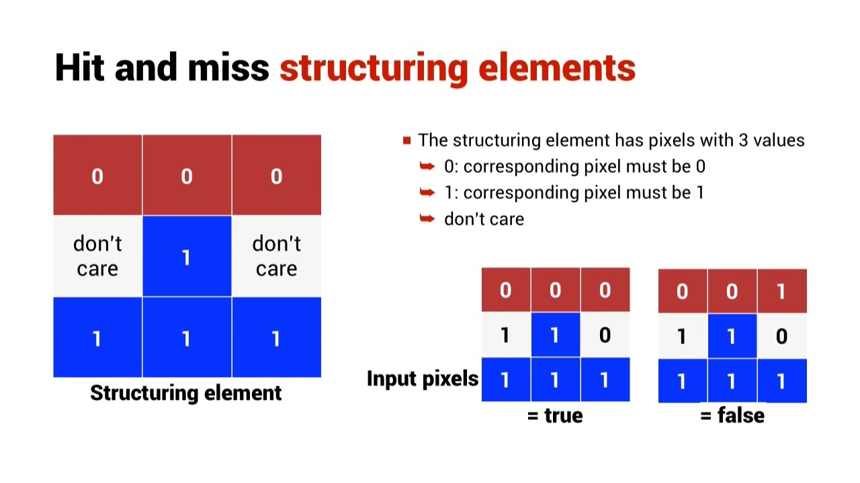

Slide 10
Hit-or-Miss Transform
Extended Structuring Element: Example
0 | 0 | 0 | 0 | 0 | 0 | 0 | 0
0 | 0 | 1 | 1 | 1 | 0 | 0 | 0
0 | 0 | 0 | 0 | 1 | 1 | 1 | 0
0 | 1 | 0 | 0 | 1 | 1 | 1 | 1
0 | 1 | 1 | 1 | 1 | 1 | 0 | 1
0 | 0 | 1 | 1 | 1 | 1 | 0 | 1
-
1
1
1
0
0
Erosion Recap: Slide the SE on the image and look for the ‘fits’

Slide 11
Hit-or-Miss Transform
Extended Structuring Element: Example
0 | 0 | 0 | 0 | 0 | 0 | 0 | 0
0 | 0 | 1 | 1 | 1 | 0 | 0 | 0
0 | 0 | 0 | 0 | 1 | 1 | 1 | 0
0 | 1 | 0 | 0 | 1 | 1 | 1 | 1
0 | 1 | 1 | 1 | 1 | 1 | 0 | 1
0 | 0 | 1 | 1 | 1 | 1 | 0 | 1
‘Fit’ encountered
-
1
1
1
0
0

Slide 12
Hit-or-Miss Transform
Extended Structuring Element: Example
0 | 0 | 0 | 0 | 0 | 0 | 0 | 0
0 | 0 | 1 | 1 | 1 | 0 | 0 | 0
0 | 0 | 0 | 0 | 1 | 1 | 1 | 0
0 | 1 | 0 | 0 | 1 | 1 | 1 | 1
0 | 1 | 1 | 1 | 1 | 1 | 0 | 1
0 | 0 | 1 | 1 | 1 | 1 | 0 | 1
-
1
1
1
0
0
‘Fit’ encountered

Slide 13

Hit-or-Miss Transform
What we actually did???
Extended Structuring Element: Example
Output
0 | 0 | 0 | 0 | 0 | 0 | 0 | 0
0 | 0 | 1 | 1 | 1 | 0 | 0 | 0
0 | 0 | 0 | 0 | 1 | 1 | 1 | 0
0 | 1 | 0 | 0 | 1 | 1 | 1 | 1
0 | 1 | 1 | 1 | 1 | 1 | 0 | 1
0 | 0 | 1 | 1 | 1 | 1 | 0 | 1
0 | 0 | 0 | 0 | 0 | 0 | 0 | 0
0 | 0 | 0 | 0 | 0 | 0 | 0 | 0
0 | 0 | 0 | 1 | 0 | 0 | 0 | 0
0 | 0 | 0 | 0 | 0 | 0 | 0 | 0
0 | 0 | 0 | 0 | 0 | 0 | 1 | 0
0 | 0 | 0 | 0 | 0 | 0 | 0 | 0
-
1
1
1
0
0
We have searched the pattern in the structuring element in the image

Slide 14
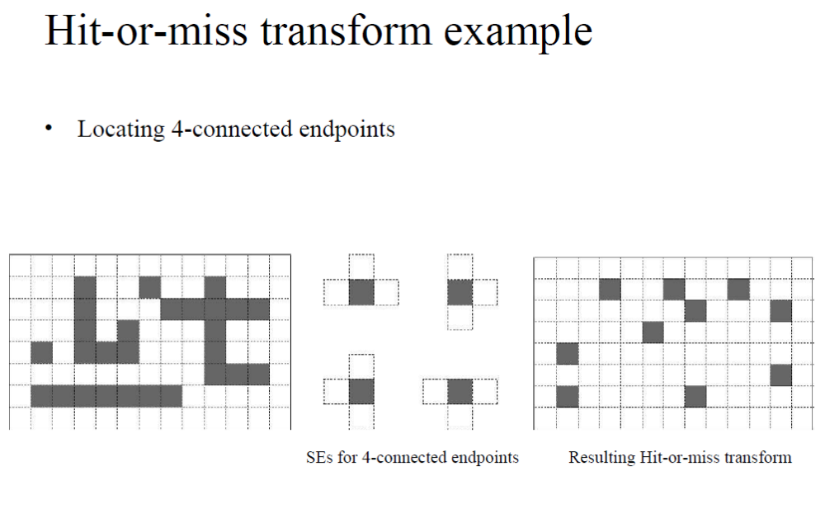

Slide 15
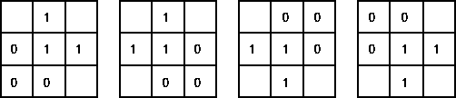
Corner Detection with Hit-and-miss Transform
Structuring Elements representing four corners

Slide 16

Corner Detection with Hit-and-miss Transform
Apply each Structuring Element
Use OR operation to combine the four results

Slide 17
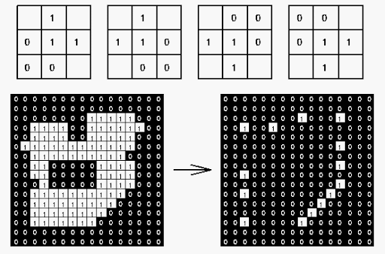
Corner Detection with Hit-and-miss Transform

Slide 18

Hit-and-Miss Transformation
Alternative definition:
A background is necessary to detect disjoint sets.
When we only aim to detect certain patterns within a set, a background is not required, and simple erosion is sufficient.

Slide 19
Some basic Morphological Algorithms
When dealing with binary images, the principle application
of morphology is extracting image components that are useful
in the representation and description of shape
Using the simple technique we have looked at so far we can begin to consider some more interesting morphological algorithms.
We will look at:
  Boundary extraction
  Region filling
There are lots of others as well though:
  Extraction of connected components
  Thinning/thickening
  Skeleton

Slide 20
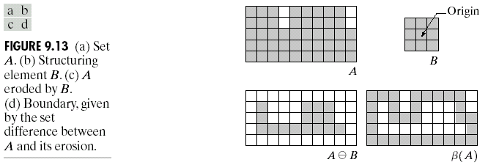
Boundary Extraction
Extracting the boundary (or outline) of an object is often extremely useful
The boundary can be given simply as
β(A) = A – (AB)

Slide 21
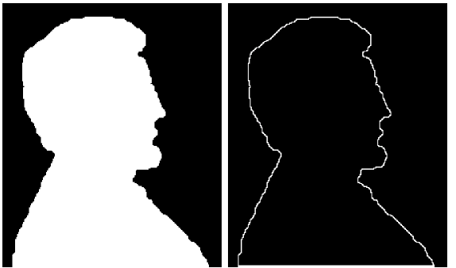
Boundary Extraction Example
A simple image and the result of performing boundary extraction using a square 3*3 structuring element
Original Image
Extracted Boundary

Slide 22
Home Work
What is the smallest number of different structuring elements that you would need to use to locate all foreground points in an image which have at least one foreground neighbor, using the hit-and-miss transform? What do the structuring elements look like?

Slide 23
Thinning
( ) (Subtracting Pixels from a Shape)
Used to remove selected foreground pixels from binary images
After edge detection, lines are often thicker than one pixel.
Thinning can be used to thin those line to one pixel width.

Slide 24
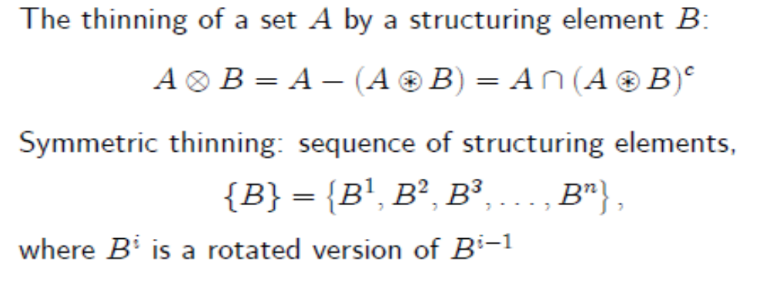

Definition of Thinning
.
Let K be a kernel and I be an image
If foreground and background fit the structuring element exactly, then the pixel at the origin of the SE is set to 0
Note that the value of the SE at the origin is 1 or don’t care!
where the subtraction is a logical subtraction defined by

Slide 25
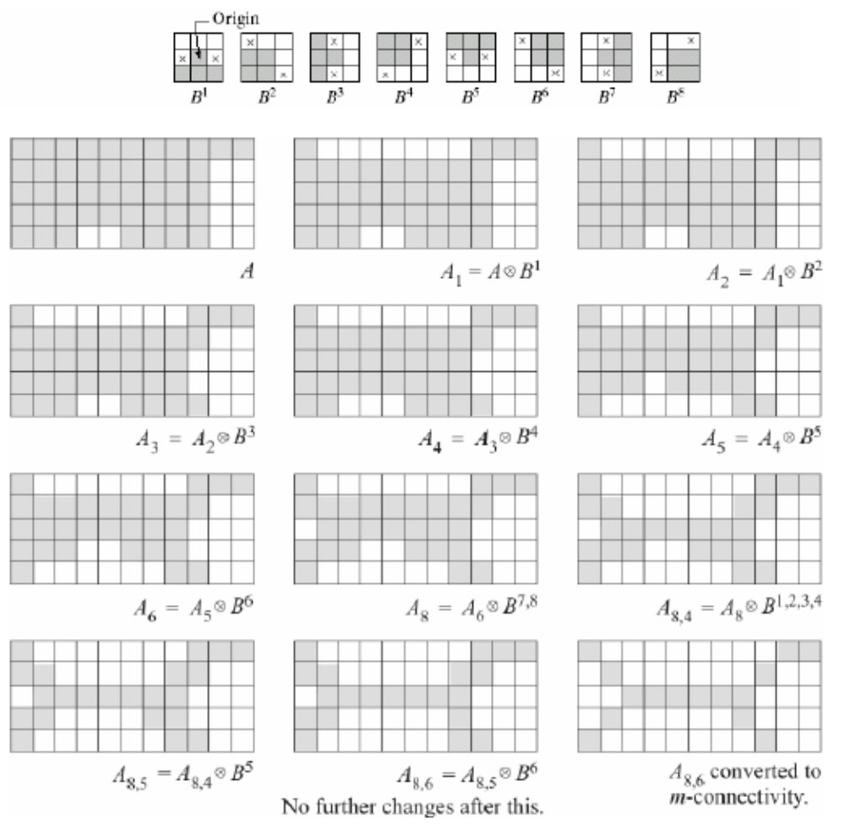
Thinning
Illustration:

Slide 26
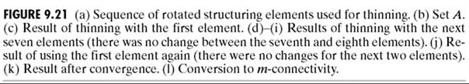
Thinning Illustration:

Slide 27

Thinning Illustration:

Slide 28
Thinning Illustration:

Slide 29


Thinning Illustration:

Slide 30
Thickening ( )
(Adding Pixels to a Shape)
Used to grow selected regions of foreground pixels
E.g. applications like approximation of convex hull

Slide 31
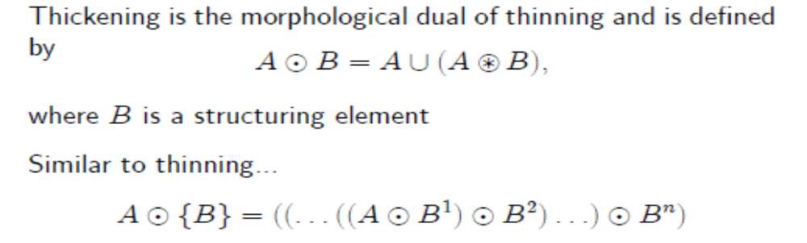
Definition Thickening
If foreground and background match exactly the SE, then set the pixel at its origin to 1!
Note that the value of the SE at the origin is 0 or don’t care!

Slide 32
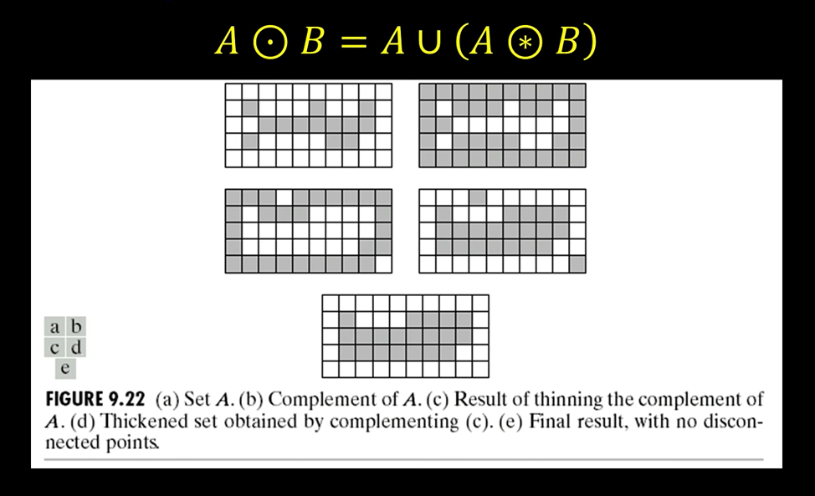
A Separate Thickening Algorithm
Thin the background instead, then complement the result!

